Slide 1
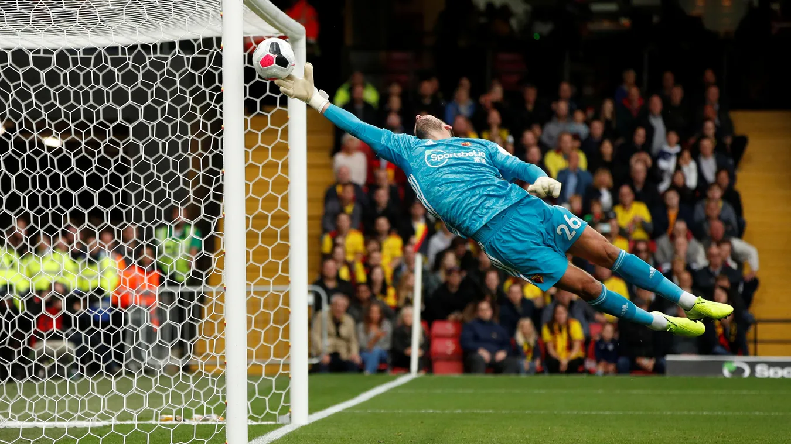
Premier league Predictive Analysis
September 2022

Slide 2
team
Edwin Yu
- Machine Learning
- Visualization
Parker Jones
- Visualization
Kwasi Sefah
- Machine Learning
- Visualization
Sam Caslowitz
- Machine Learning
Trevor Jackson
- Database
- Visualization

Slide 3
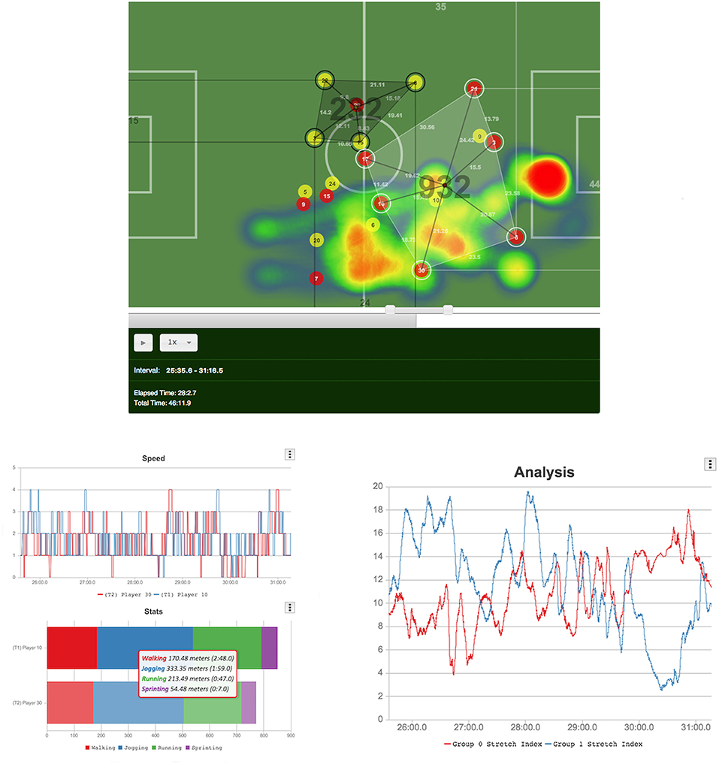
Project Overview
Sports statistics and analytics has been increasingly popular across all sports as analytical tools have become more available and powerful.
Higher volumes and precision of data has become more readily available, but the dynamics of team sports has remained the same.
Our goal with this project is to use historical season data from the Premier League in English Football (or Soccer) to create predictive models that can influence team decision making.

Slide 4
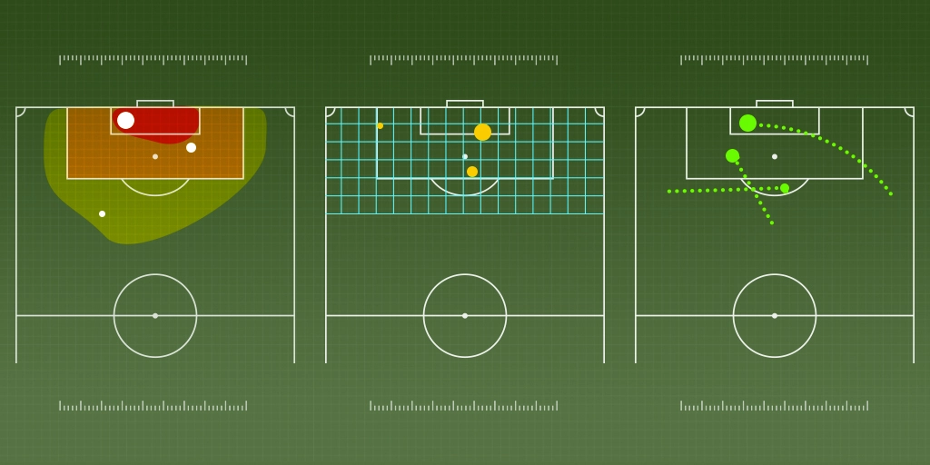
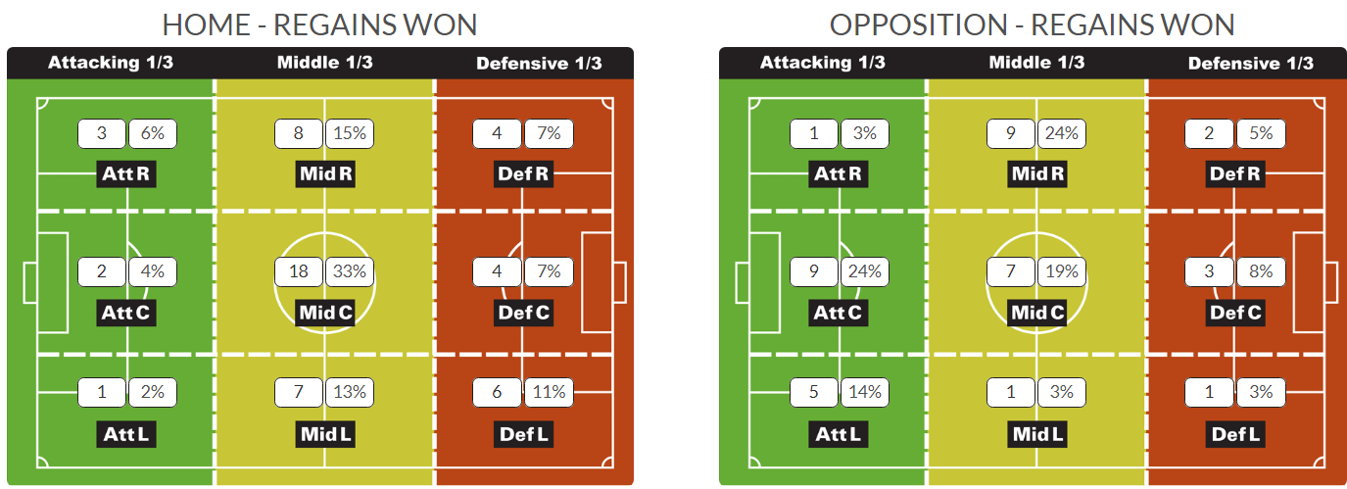
THESIS Can we look at the past 5 years of Premier League data and predict this year’s results?
Ideas Worth Exploring
How does a red card affect the outcome of a game?
Is the home team advantage real?
Is it possible to predict the Ballon D’Or qualifiers?
Do larger contracts win more games?
Can individual players win the World Cup for their team?
What’s the most important variable in determining ticket sales?
How do age and experience affect scoring potential?

Slide 5
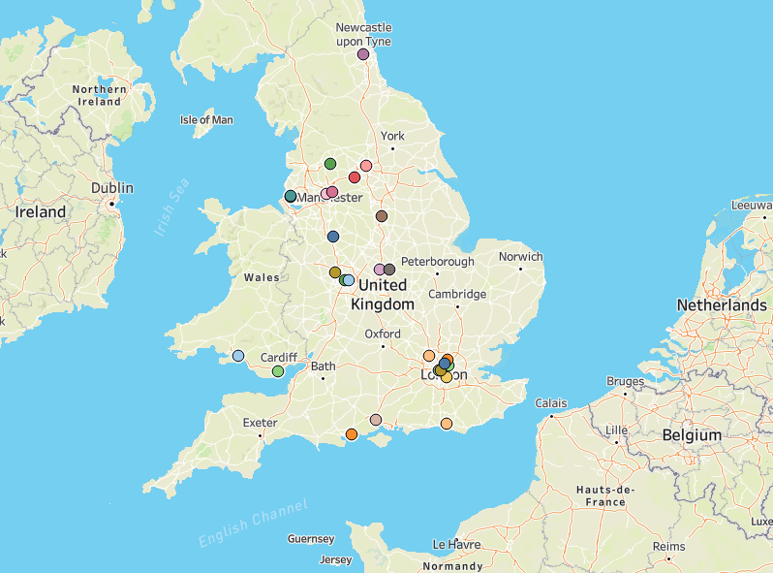
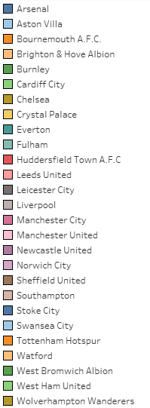
Geographic location of teams
PREMIER LEAGUE PREDICTIVE ANALYSIS

Slide 6
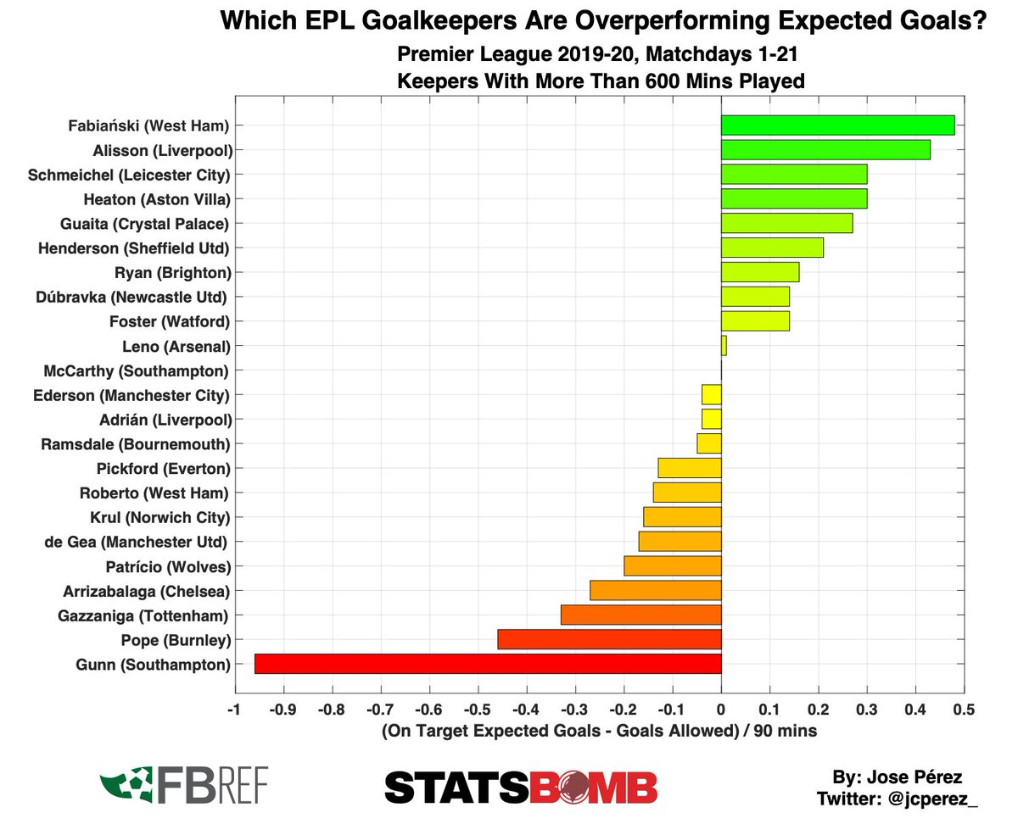
Metrics considered
Total Wins/Losses
Home Wins/Losses/Draws
Away Wins/Losses/Draws
Goal Differential
Goals Scored/Goals For
Goals Allowed/Goals Against
Expected Goals
Expected Goals Against
Player Salary
Yearly Expenditure
Yellow Cards
Red Cards
Fouls
Possession Time
Clean Sheets
Corners
Clearance Off-Line
Tools/Libraries Used
SQL
Pandas
Matplotlib
Tableau
statsmodels.api
sklearn library:
LinearRegression, datasets, minmaxscaler, rfe, accuracy_score, train_test_split, cross_val_score, RandomForestClassifier

Slide 7
Project objectives
The Model
Create a Linear Regression model based on the Premier League’s last five years’ worth of gameplay statistics. Ideally, this model will consider some of the previously mentioned metrics.
Then apply the Random Forest model to create a matrix of predicted results for the 2022 season. This should provide enough information to determine the expected league standings for each team.

Slide 8
Sources and Database
Most of the data was pulled from the FBREF section of the sports statistic website Sports Reference.
The website can filter by various league, player, and team criteria; exported as a CSV file for easy analysis.
For the purposes of this project, the range of data used was for the seasons spanning 2017 to 2022.
 | Category 1 | Category 2 | Category 3 | Category 4
Item 1 | 4.5 | 2.3 | 1.7 | 5
Item 2 | 3.2 | 5.1 | 4.4 | 3
Item 3 | 2.1 | 1.7 | 2.5 | 2.8
Item 4 | 4.5 | 2.2 | 1.7 | 7

Slide 10
Cleaning, Collating, and Interpreting
Clean CSV Files
Remove any irrelevant information to make the files more manageable. Join relevant CSV files on common categories.
Visualize Data
Graphically represent the data and observe. Take special note of any outliers, trends, or inconsistencies.
Linear Regression
Random Forest
Use the Random Forest module to create a best fit model mapped to our data points.
Predictive Analysis
Create expected league standings based on the model. There are many dependent variables, so even minor adjustments can cause major shifts in the results.
Once the data is well represented, perform linear regressions on various metrics to quantitatively define any significant observations.

Slide 11
Linear Regressions

Slide 12
Results from the Model
Subtitle
Subtitle
Subtitle
Add text, images, art, and videos.
Add transitions, animations, and motion.
Save to OneDrive, to get to your presentations from your computer, tablet, or phone.
Open the Design Ideas pane for instant slide makeovers.
When we have design ideas, we’ll show them to you right there.
This PowerPoint theme uses its own unique set of colors, fonts, and effects to create the overall look and feel of these slides.
PowerPoint has tons of themes to give your presentation just the right personality.

Slide 13
Random forest

Slide 14
Results from the model

Slide 15

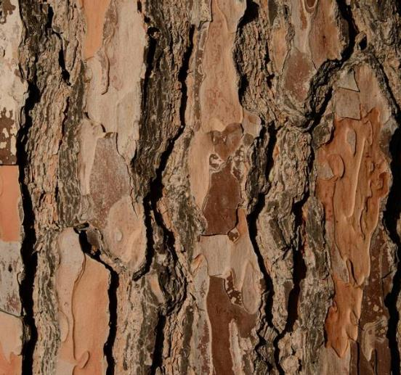


Challenges
With PowerPoint, you can create presentations and share your work with others, wherever they are. Type the text you want here to get started. You can also add images, art, and videos on this template. Save to OneDrive and access your presentations from your computer, tablet, or phone. ​

Slide 16

Potential Further Analyses
Additional Questions raised by the project.

Slide 17
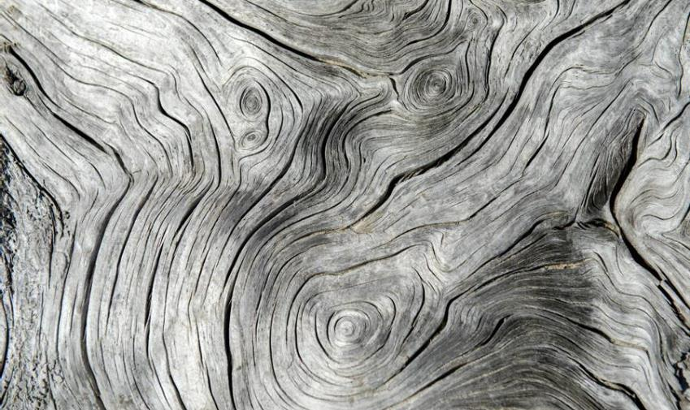

Thank you
Presenter Name | Email | Website

